Slide 1
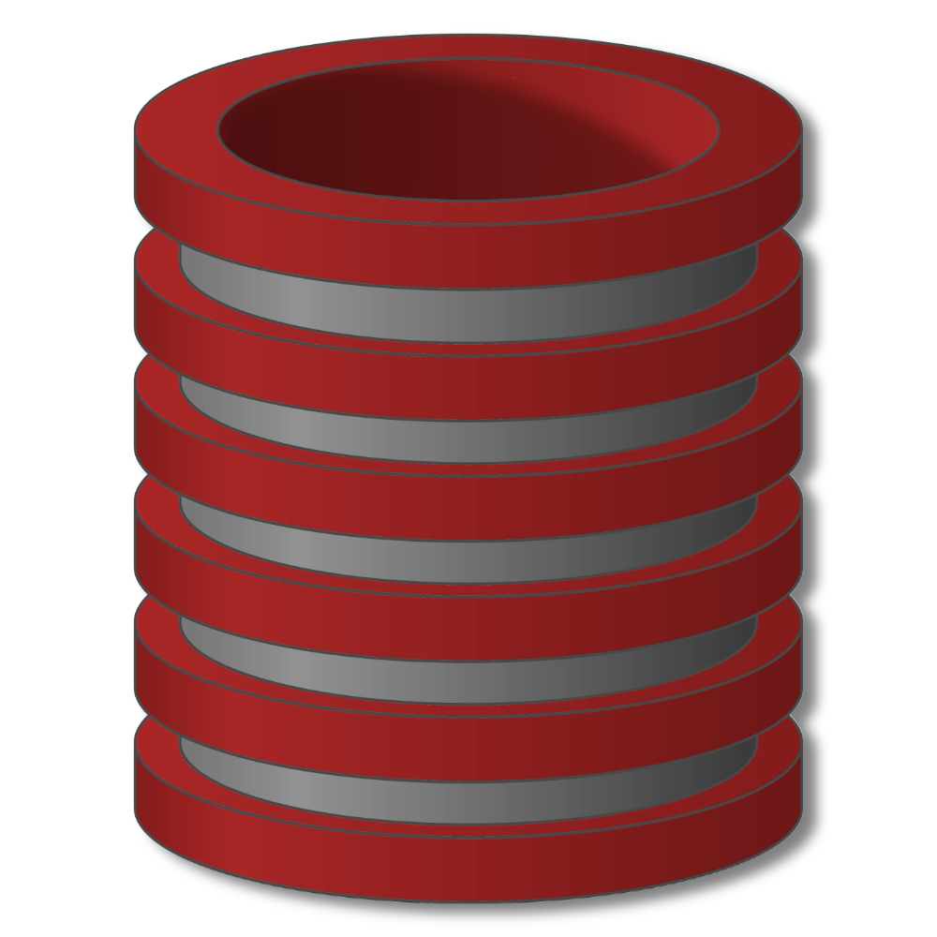
Indexes

Slide 2
Indexes
Indexes
Primary mechanism to get improved performance
on a database
Persistent data structure, stored in database
Many interesting implementation issues
But we are focusing on user/application perspective
Notes:
The reason indexes are so important is that they are the primary way of getting improved performance out of a database. Indexes are a persistent data structure. They're stored together with the database itself. Now, there are many very interesting implementation issues in indexes, but in this lecture and in this course in general, we're focusing on the perspective of the user and application. So, we'll talk about how applications will use indexes to speed up performance.

Slide 3
Indexes
Functionality
T
Index
on T.A
 | A | B | C
1 | cat | 2 | …
2 | dog | 5 | …
3 | cow | 1 | …
4 | dog | 9 | …
5 | cat | 2 | …
6 | cat | 8 | …
7 | cow | 6 | …
 | … | … | …
Notes:
So, let's suppose we have a very simple table T that has three columns, but we're going to focus on columns A and columns B. And we can see that Column A is a string valued column with animal names, and Column B is an integer column. Now, we're gonna be asking queries that involve conditions over these two columns. In order to speed up those queries, if we're concerned about evaluating conditions on column A, then we can build an index on that column. So we call that an index on column T.A. What that index allows us to do - and "us" in this case is actually the query processor - is ask questions, for example, let's ask what tuples have "cow" in the value of T.A. If we ask that question of our index, that that index will quickly tell us that tuple 3 and tuple 7 have a value "cow", without scanning the entire table. We could also ask the index what tuples have say, value "cat". And if we ask the index that question, it will tell us tuple 1 and tuple 5 and tuple 6 have the value "cat."

Slide 4
Indexes
Functionality
T
Index
on T.A
 | A | B | C
1 | cat | 2 | …
2 | dog | 5 | …
3 | cow | 1 | …
4 | dog | 9 | …
5 | cat | 2 | …
6 | cat | 8 | …
7 | cow | 6 | …
 | … | … | …
Index
on T.B
Notes:
If we're interested in evaluating conditions in column B then we can also build an index on column B. For example now we could ask questions like, when is T.B equal to the value two? We asked the index and the index will tell us that tuple 1 and tuple 5 have the value two. We could also ask, for example, when the value in T.B is less than six? And the index in that case would tell us that tuples 1,2,3,5 are less .
We could ask an even more complicated question. We could ask when the value for T.B is say, greater than four and less than or equal to eight. Again, we ask the index, and in this case the index would tell us that it is tuple two, six and tuple seven in that case.

Slide 5
Indexes
Functionality
T
Index
on T.A
 | A | B | C
1 | cat | 2 | …
2 | dog | 5 | …
3 | cow | 1 | …
4 | dog | 9 | …
5 | cat | 2 | …
6 | cat | 8 | …
7 | cow | 6 | …
 | … | … | …
Index
on T.(A,B)
Index
on T.B
Notes:
Lastly, suppose we're interested in having conditions that are on both columns A and B. Then we can build an index that is on both columns together. Now we could ask questions, for example, like, when is T.A equal to cat and T.B, say, greater than five? Do we have any of those? Well, we have just one of them there. That's tuple six. We could also have inequalities, by the way, on the first column. So we might ask, when is T.A less than, say the value ‘D’, and T.B equal to say the value 1, and in that case we'll get the tuple 3 as a result.

Slide 6
Indexes
Utility
Index = difference between full table scans and
immediate location of tuples
Orders of magnitude performance difference
Underlying data structures
Balanced trees (B trees, B+ trees)
Hash tables
Notes:
So I think this gives an idea with a simple table of how indexes are used to go directly to the tuples that satisfy conditions rather than scanning the entire table. So that's the main utility of an index. Again, the tables can be absolutely gigantic in databases and the difference between scanning an entire table to find that tuples that match a condition and locating the tuples, more or less immediately using an index, can be orders of magnitude in performance difference. So really it's quite important to take a look at the database and build indexes on those attributes that are going to be used frequently in conditions, especially conditions that are very selective. Now I mentioned that we're not covering the implementation of indexes in this lecture, but it is important to understand the basic data structures that are used. Specifically there are two different structures.
Now there is one small downside. For those of you who are familiar with the structures and with the running time, the operations on the balance trees tend to be logarithmic in their running time, while well designed hash tables can have more or less constant running time. Even in large databases, logarithmic is okay, although when only equality conditions are being used, then a hash table index might be preferred.
One of them is balanced trees and substantiation of that is typically what's called a B-tree or a B+tree. And the other is hash tables. Now balanced trees indexes can be used to help with conditions of the form "attribute equals value." They can also be used for "attribute less than value," for "attribute between two values" and so on, as we have shown earlier. Hash tables, on the other hand, can only be used for equality conditions. So only attribute equal value. And if you're familiar with these structures then you'll know why there's the limit on hash tables. So balanced tree indexes are certainly more flexible.

Slide 7
B-tree Indexing: Concept
Can be seen as a general form of multi-level indexes.
Generalize usual (binary) search trees (BST).
Allow efficient and fast exploration at the expense of using slightly more space.
Popular variant: B⁺-tree
Support more efficiently queries like:
SELECT * FROM R WHERE a = 11
SELECT * FROM R WHERE 0<= b and b<42

Slide 8
B-tree Indexing: Example
Looking for Empno 250
200
220
250
280
130
9
20
100
200
210
215
250
256
279
140
145
220
230
280
300
RID list
Each node stored in one disk block

Slide 9
Indexes
Select sName
From Student
Where sID = 18942
Many DBMS’s build indexes automatically on
PRIMARY KEY (and sometimes UNIQUE) attributes
Notes:
Now, let's take a look at a few SQL queries and see how indexes might allow the query execution engine to speed up processing. We'll use our usual student and university database.
The first one is a very simple query, it's looking for the student with a particular student ID. So if we have an index on the student ID then again the index will allow the query execution engine to go pretty much straight to that tuple, whereas without an index the entire student table would have to be scanned. Now let me mention that many database systems do automatically build indexes on primary keys. So it's likely that in an application the student ID would be declared as a primary key and there would be an index automatically. But it's a good thing to check if this type of query is common. And some systems even also build indexes automatically on attributes that are declared as unique.

Slide 10
Indexes
Select sID
From Student
Where sName = ‘Maryiam’ And GPA > 3.9
Notes:
Now let's take a look at a slightly more complicated example. Here we're looking for students whose name is Mariyam and whose GPA is greater then 3.9, and there may be a few of those students. So one possibility is that we have an index on the student name and if that is the case, expand the query processing can find quickly the tuples whose student name is Mariyam, and then check each one of those to see if the GPA is greater than 3.9. Alternatively we might have an index on the GPA. In that case, the system will use the index to find the students whose GPA is greater than 3.9 and then look to see if their name is Mariyam. Finally, it is possible we can have an index on the two attributes together so we can have Sname and GPA together and then this index can be used to simultaneously find students that have the name Mariym and the GPA greater than 3.9. Now, I should mention that because this is an inequality condition, it is important that the GPA is a tree based index in order to support that evaluation of this condition where the student name is an equality condition so that could be a hash based index or a tree based index.

Slide 11
Indexes
Select sName, uName
From Student, Apply
Where Student.sID = Apply.sID
Notes:
Now let's look at a query that involves a join. We're joining the student and apply tables in order to find the names of the universities that each student has applied to. And we're returning the student name and the university name. So let's suppose for starters that we had an index on the student ID attribute of the apply relation. If that's the case then the query execution engine can scan the student relation and, for each student, use that SID and quickly find the matching SIDs in the apply relation. Alternatively, let's suppose we had an index on the SID attribute of the student relation. In that case, the system could scan the apply relation, and, for each student ID and each apply tuple, find the matching student IDs in the student tuple using the index that we have there. In some cases it's actually possible to use the two indexes together and make the query run even faster.

Slide 12
Indexes
Downsides of Indexes
1) Takes extra space
2) Index creation
3) Index maintenance
Notes:
So, indexes seem like great things. We just throw some indexes onto our data and all of a sudden our queries run much, much faster. So, there must be some downsides, and of course, there are. Let me list three of them from sort of least severe to most severe. So, the first one is that indexes do take up extra space. As I mentioned, they are persistent data structures that resides with the data. I consider this sort of a marginal downside especially with the cost of disk these days its really not that big of deal to use additional space, even to potentially double the size of your database. The second downside is the overhead involved in index creation. So, when a database is loaded, if we're going to have indexes, those indexes need to be created over the data. Or if we add indexes later on, they need to be created. Index creation can actually be a fairly time consuming operation, so I'm going to make this as a medium downside. On the other hand, once the index is created, all the queries run faster, so it's usually worthwhile to do it. The last one is the most significant one and that's the issue of index maintenance. So the index is a data structure that sits to the side of the database and helps answer conditions. When the values in the database change, then the index has to be modified to reflect those changes. So if the database is modified frequently, each of those modifications is going to be significantly slower than if we didn't have indexes. So in fact, in a database that's modified a whole bunch and not queried all that often, the cost of index maintenance can actually offset the benefits of having the index. So it really is a cost-benefit trade off to decide when to build indexes. So given that we have this cost-benefit trade off.

Slide 13
Indexes
Picking which indexes to create
Benefit of an index depends on:
Size of table
Data distributions
Query vs. update load
Notes:
The benefit of an index depends first of all on how big the table is since the index helps us find specific portions of the table quickly.
It also depends on the data distributions. For unique attributes, indexes significantly improve performance compared to indexes on non-unique attributes.
And finally how often we're going to query the database VS how much we're going to update it. As I mentioned, every time the database is updated indexes needed to be maintained and that's costly. Every time we query the indexes may help us answer our queries more quickly.

Slide 14
Indexes
“Physical design advisors”
Input: database (statistics) and workload
Output: recommended indexes
Database statistics
Query Optimizer
Query or update
Indexes
Best execution plan
with estimated cost
Notes:
Fortunately, over the last decade or so, many database system vendors have introduced what's called a physical design advisor. In this case, physical design means determining which indexes to build on a database. The input to the design advisor is the database itself and the workload. The workload consists of the sets of queries and updates that are expected to be performed on the database as well as their frequency. Now actually the design advisor doesn't usually look at the entire database, but rather looks at statistics on the database that describe how large the tables are and their data distributions. The output of the design advisor is a recommended set of indexes to build that will speed up the overall workload. Interestingly, physical design advisors rely very heavily on a component of database systems that already existed, actually one of the most important components of database systems, which is the query optimizer. That's the component that takes a query and figures out how to execute it. Specifically, it'll take statistics on the database, the query to be executed or the update command, and the set of indexes that currently exist, and it will explore the various ways of actually executing the query, which indexes will be used, which order things will be done in. It estimates the cost of each one, and it spits out the estimated best execution plan with the estimated cost. So now let's look at how this component can be used to build a design advisor. Let's just draw the design advisor around the whole thing here, and the input to the design advisor, again, are the statistics and the workload, and the output is supposed to be the indexes. So what the design adviser actually does is it experiments with different set-ups of indexes. For each set-up of indexes, it takes the workload, it issues the queries, and updates to the query optimizer. It doesn't actually run them against the database and see's what cost the query optimizer produces. It tries this with different configurations of indexes and then in the end determines those indexes that bring down the cost the most. In other words, it will give you back those indexes where the benefits of having the index outweigh the drawbacks of having that index in terms of the workload and using the costs that were estimated by the query optimizer. If you're using a system that doesn't have a design adviser, then you'll have to kind of go through this process yourself. You'll have to take a look at the queries and updates that you expect, how often you expect them to happen, and which indexes will benefit those queries, and hopefully won't incur too much overhead when there are updates.

Slide 15
Indexes
SQL Syntax
Create Index IndexName on T(A)
Create Index IndexName on T(A1,A2,…,An)
Create Unique Index IndexName on T(A)
Drop Index IndexName
Notes:
All indexes are given names. We can create an index on a single attribute. We can create an index on several attributes together. We can also say that we want our index to enforce a uniqueness constraint so when we add the word unique it sort of adds constraint enforcement. It says, we're going to check that all values for "A" are unique using our index and will generate an error if there are two values that have the same, two tuples that have the same value for A, and finally we have a command for dropping indexes.

Slide 16
Indexes
Indexes
Primary mechanism to get improved performance
on a database
Persistent data structure, stored in database
Many interesting implementation issues
But we are focusing on user/application perspective
Notes:
In summary, indexes are really important. They're the primary way to get improved performance on a database. By building the right indexes over a database for its work flow we can get orders of magnitude performance improvement. Although we do have to be careful, because there are trade-offs in building indexes, especially for databases that are modified frequently. There are persistent data structure that are stored together with the database, and there are many interesting implementation issues, but in this lecture and course we're focusing specifically on the user and application perspective, determining which indexes to build and how they will gain performance improvement for us.

